Slide 1
Introduction to Deep Neural Networks
Course material at: https://git.io/fjFga
Wednesday, Lecture 1
FASE ML Bootcamp
Based on material from:
3blue1brown on YouTube,
Andrew Ng, Stanford CS230,
Deep learning, Nature review

Slide 2
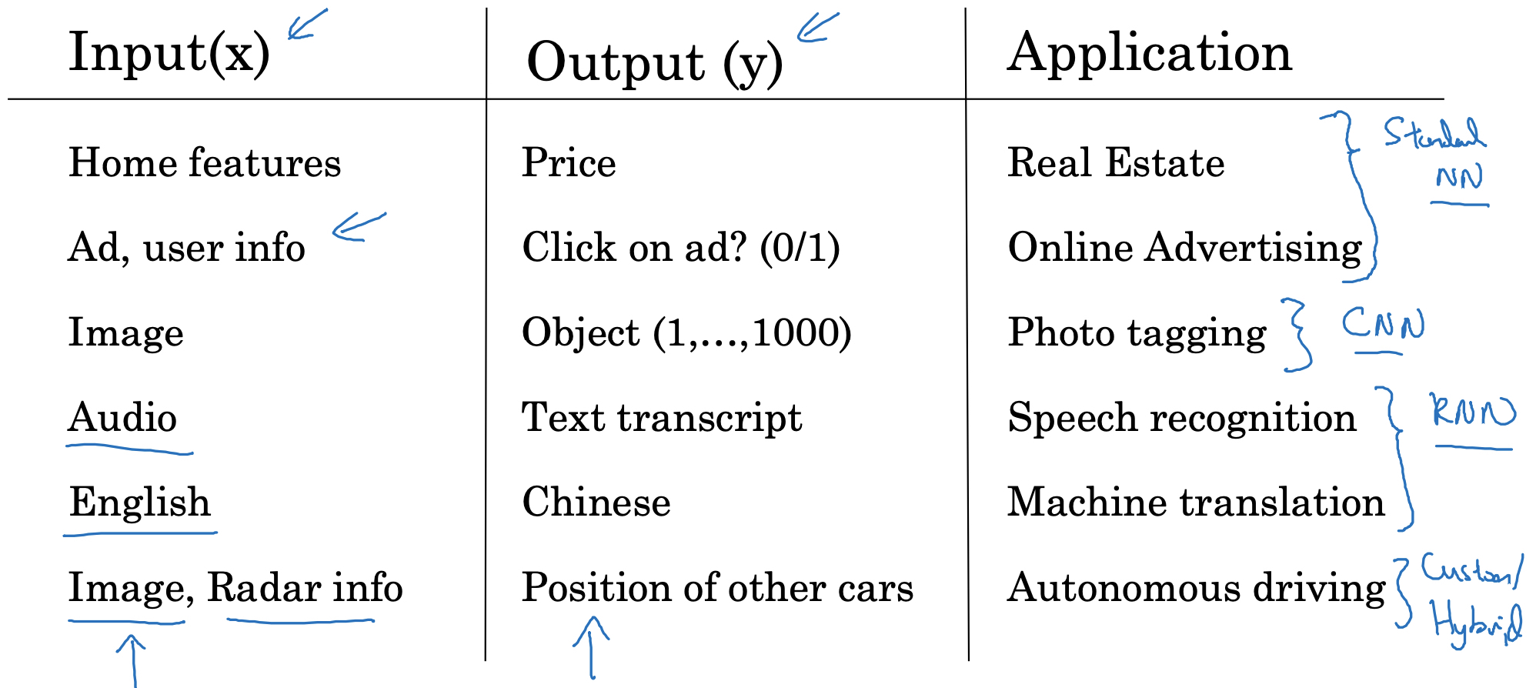
Supervised learning
From Andrew Ng’s slides, Stanford CS230

Slide 3
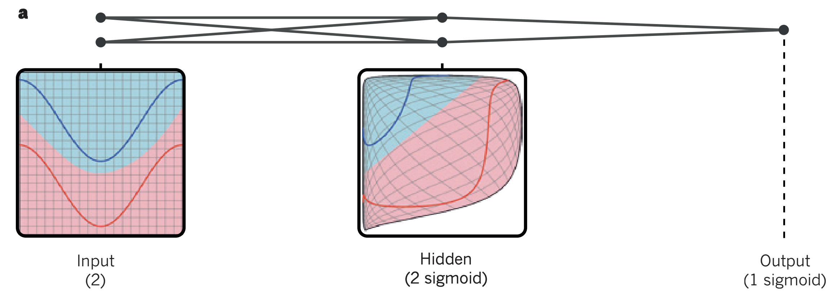
A simple neural net
Deep learning, Nature Review (2015)

Slide 4
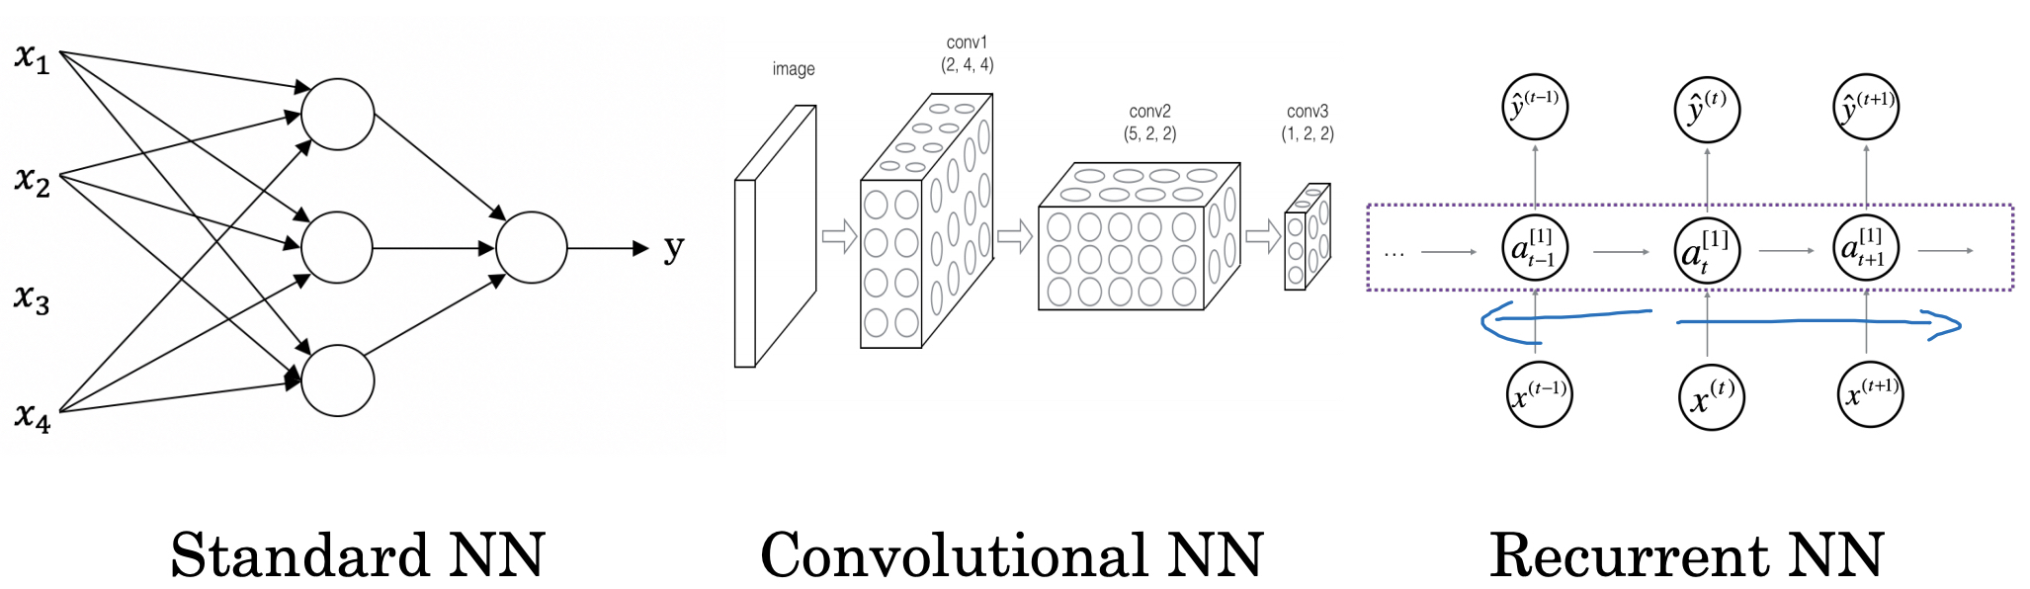
Neural Network types
From Andrew Ng’s slides, Stanford CS230

Slide 5
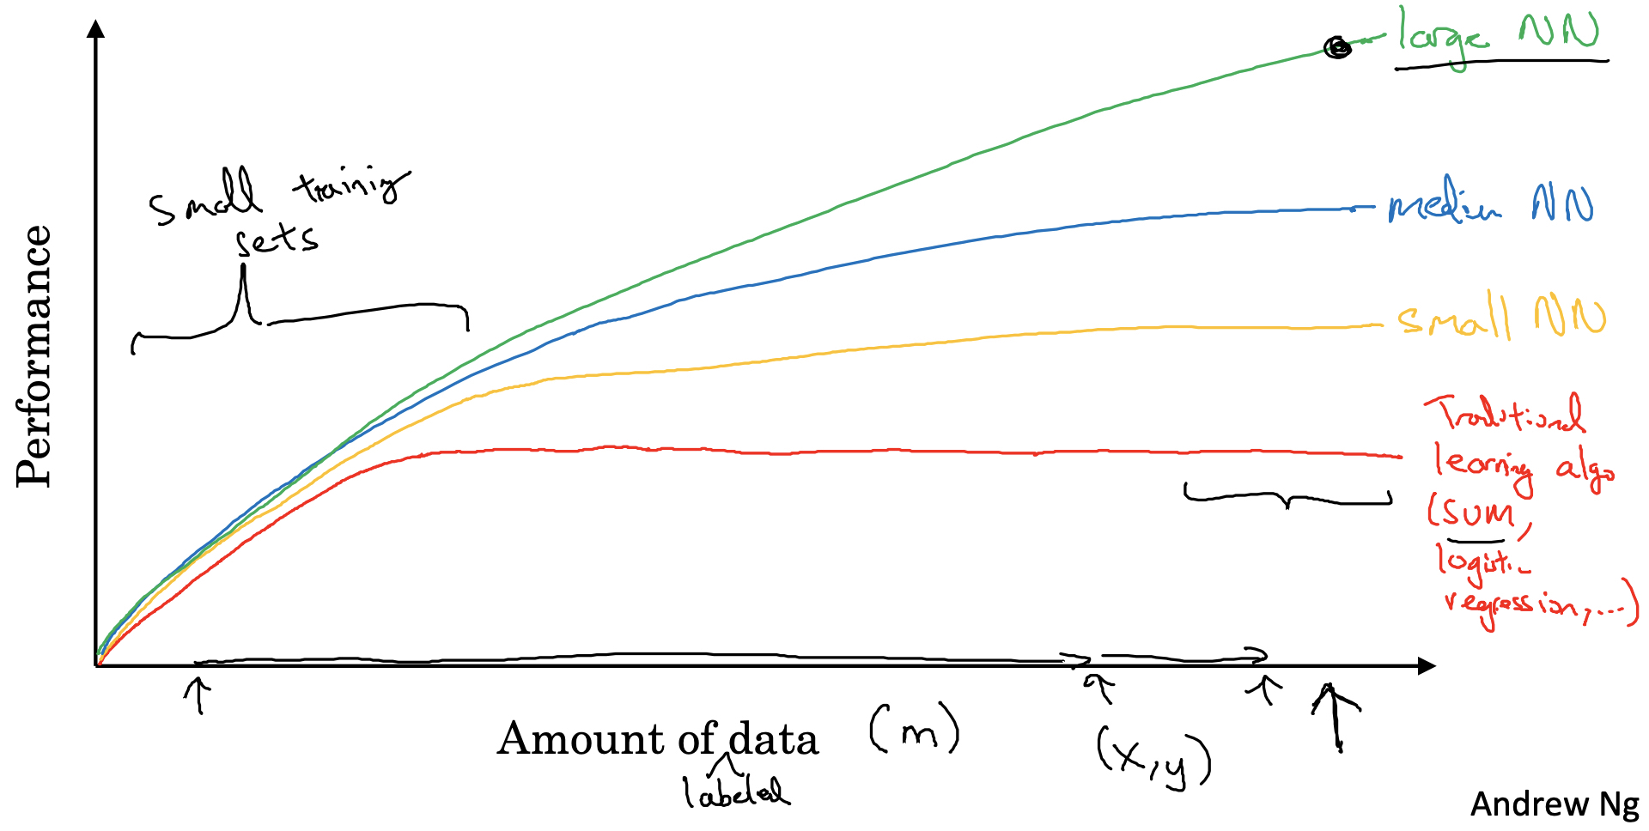
Scale drives deep learning
From Andrew Ng’s slides, Stanford CS230

Slide 6
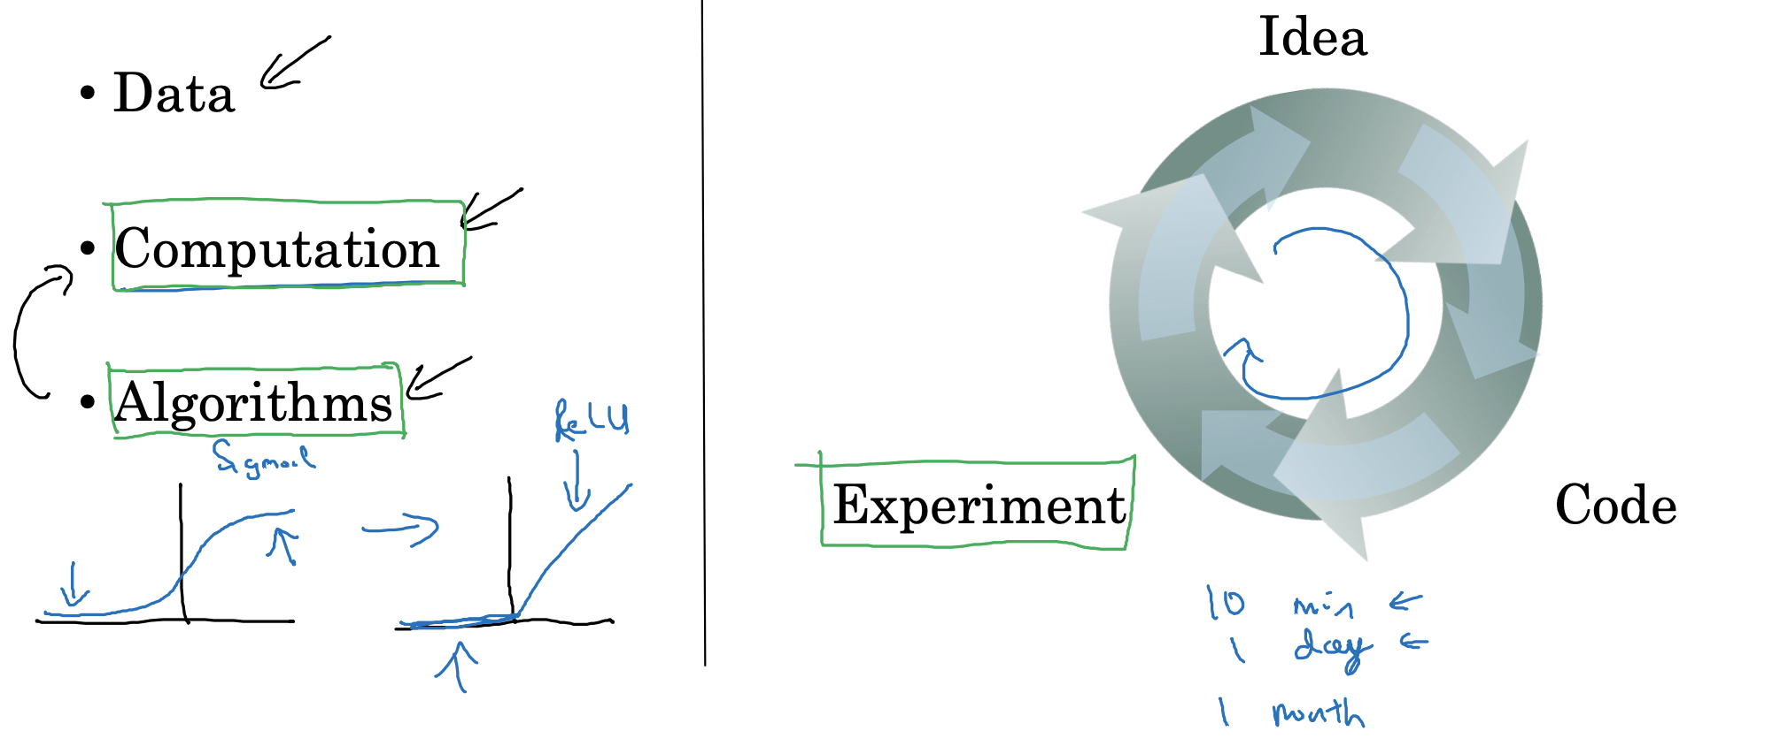
Scale drives deep learning progress
From Andrew Ng’s slides, Stanford CS230

Slide 7
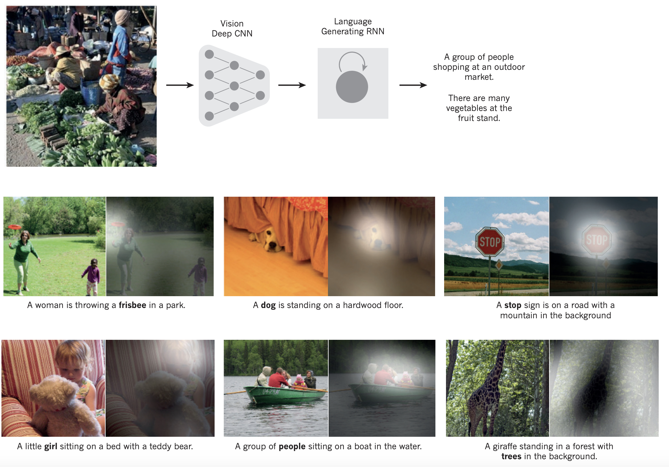
Deep learning, Nature Review (2015)

Slide 8
Deep learning, Nature Review (2015)

Slide 9
How do neural networks train?
https://www.3blue1brown.com/neural-networks
1st video
For written notes describing the content in the videos, this is a great resource
http://neuralnetworksanddeeplearning.com/index.html

